Slide 1
HTML5 and CSS3
Responsive Design

Slide 2
Fixed, fluid, Adaptive and Responsive
Fixed websites have a set width and resizing the browser or viewing it on different devices won’t affect the way the website looks.
Fluid websites are built using percentages for widths. As a result, columns are relative to one another and the browser allowing it to scale up and down fluidly.
Adaptive Web sites aren't necessarily built on a fluid grid. They can also use a fixed grid and introduce media queries to target device sizes, like smaller monitors, tablets, and Smart phones.
Responsive websites are built on a fluid grid and use media queries to control the design and its content as it scales down or up with the browser or device.
http://teamtreehouse.com/library/build-a-responsive-website/introduction-to-responsive-web-design/fixed-fluid-adaptive-and-responsive-2
http://www.dimensionsapp.com/a/

Slide 3
Why Responsive?
Essentially, there are just too many mobile devices hitting the market to tailor our websites to view well on them all.
Nearly every device released has a different screen size and resolution than it’s predecessor. It simply doesn’t make sense for companies big and small to spend the time and money to create a bespoke web experience for each device in the ever expanding line-up.
RWD is one of the simplest and quickest ways to make a website work handsomely on a lot of devices—and you can use the web skills you already have.

Slide 4
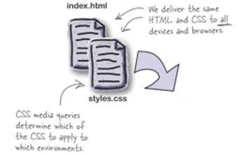
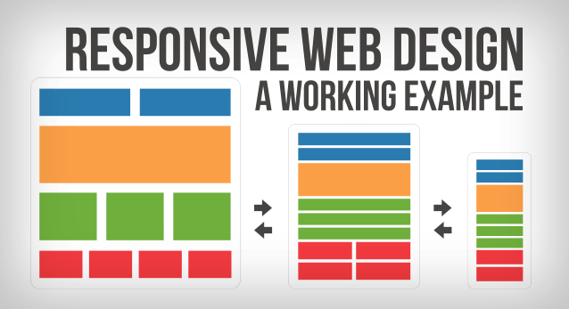

Slide 5
What is Responsive Design
Responsive design is when your website design can adapt to the width and height of the device it is being viewed on (content can adapt to the user.
Responsive design is done by using media queries in your CSS file to change the styling of your HTML elements depending on certain breakpoints you setup.
The breakpoints define a range of widths which will use different CSS styles.
This is typically different sizes of devices such as mobile phones, 7 inch tablets, 10 inch tablets, 13 inch laptops and desktop monitors.

Slide 6



The Recipe for Responsive Web Design
There are three primary techniques for building a responsively designed website:
CSS3 media queries
Use media queries not to target specific device resolutions, but rather to adjust the design and content as it reaches various breakpoints.
Fluid-grid layouts
Using relative CSS proportions instead of absolute sizes for page layout elements.
Fluid images and media
Fluid images are a CSS technique that keeps outsized images (or media) from “breaking out” of their parent elements when the parent element width is smaller than that of the image (or media). The images and media scale down as the parent element scales down.
Using a simple font-size reset on the <body> element and defining font sizes in ems or percentages keeps our type fluid.

Slide 7
CSS3 media queries
CSS3 media queries let us apply CSS selectively to different user environments based on the current value of relevant media features.
Media types (e.g., screen, print, projection) have media features (width, color, monochrome, orientation). It’s these media features we evaluate in our media queries.
A CSS media query is a logical expression. When it evaluates to TRUE, the enclosed CSS rules are applied.

Slide 8

How to Write a Media Query
A media query consists of a media type and an optional expression to check for specific media features.
For example, to define a layout for screens with a width of 480px and below.
For example, you might want to send mobile devices with a width between 400 and 800 pixels a special tablet style sheet. To define this you would write:
To print a document only on 300dpi or better printers, you could write:

Slide 9
What media type exist ?
Media Type | Explanation
all | The styles should be used for all media types.
screen | The styles should be used on color computer screens.
print | The styles should be used on paper formats and documents viewed in "print preview" mode.
tv | The styles should be used on television style devices, with low resolution, color and sound.
handheld | The styles should be used on small, usually monochrome, devices such as phones or PDAs.
projection | The styles should be used with projection devices like overheads.

Slide 10
What features can you check for?
Feature | Explanation
width | Check the width of the display area including any scroll bar. You can use min- and max- prefixes.
height | Check the height of the display area including any scroll bar. You can use min- and max- prefixes.
device-width | Check the width of the rendering surface. You can use min- and max- prefixes.
device-height | Check the height of the rendering surface. You can use min- and max- prefixes.
orientation | Check if the orientation is portrait or landscape. (There is specific code for both iPads and Android devices for handling orientation. )
Color | Check the number of color bits per color component. By just saying color you are applying the styles to all color devices. You can use min- and max- prefixes.
color-index | Check the number of color entries in the color lookup table of the device. You can use min- and max- prefixes.
Monochrome | Check the number of bits per pixel in a monochrome frame buffer. You can use just monochrome to match all monochrome devices. You can use min- and max- prefixes.
Resolution | Check the pixel density of the output device. You can use min- and max- prefixes.

Slide 11
How to Write a Media Query
You place multiple styles for different browsers and sizes into a single style sheet. This eliminates the need for multiple requests for several different sheets. CSS media type declarations inside of a CSS file look like this:
@media screen and (min-width: 600px) { .sixhundredminwidthclass { width: 30%; float: right;
} } @media screen and (max-width: 600px) { .sixhundredmaxwidth { clear: both; font-size: 1.3em; } }

Slide 12
CSS3 Media Query Code
Here’s another way of writing the queries:
This media query will trigger your foureighty style sheet if the width of the display area is 480 pixels or less.
If you prefer a different style sheet for each design, then you can use the following code as an example to do so:
<link rel="stylesheet" type="text/css“ media="screen and (max-width: 480px)“ href="foureighty.css" />
<link rel="stylesheet" media="screen and (max-width: 600px)" href="small.css" /> <link rel="stylesheet" media="screen and (min-width: 600px)" href="large.css" /> <link rel="stylesheet" media="print" href="print.css" />

Slide 13
CSS3 Media Query Code
You can also include the media query as part of an @import directive:
But in each case, the effect is the same:
If the device passes the test put forth by our media query, the relevant CSS is applied to our markup.

Slide 14
Media Keywords
Media keywords, such as "and" and "or" can group the media features together. They can also make older browsers ignore them all together if they don't support Media Queries.
and: This condition "and" this condition must equal true for browsers to apply the stylesheet.
or: This condition "or" this condition must equal true for browsers to apply the stylesheet.
not: "not" will do everything, but what you type after it. Also, older browsers that do not support media types will not recognize the "not" keyword and therefore the stylesheet is not applied.
only: Older browsers that do not support media types will not recognize the "only" keyword and therefore the stylesheet is not applied.

Slide 15
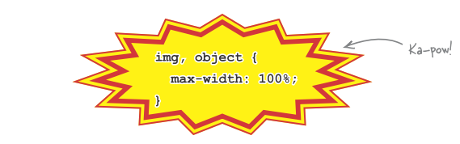
Fluid images and media
Fluid images and media, like fluid grids, scale proportionally within the layout.
With this quick addition, we help to prevent any image or embedded media object from being wider than its containing element. Because they are limited to 100% width—100% of the width of their containing element—images and media obey their parents and don’t try to break outside of the boundaries. Nice!
Just because an image scales down on a narrower screen doesn’t mean that it isn’t still, at heart, a large image. An 800 KB JPEG is still an 800 KB JPEG, even if it’s crammed down into a 120-pixel-wide column.

Slide 16
Fluid images and media
Most great things don’t come without a bit of sacrifice. To use the fluid technique on images and media, we have to forego our old friends: the width and height attributes.
The CSS rule on the previous slide will override a width attribute but will not affect a height attribute. That means that, if we use height and width attributes, we could end up with an image that scales its width but not its height. End result: a sad‑looking squished image in the wrong aspect ratio.

Slide 17
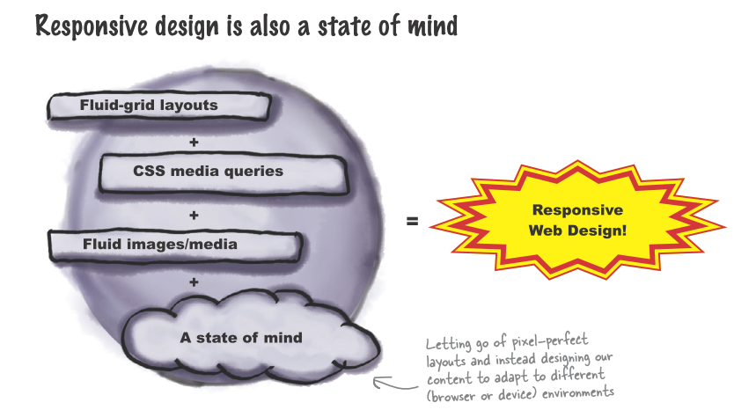

Slide 18
viewport meta tag
If you test out CSS media queries on a mobile device, you most likely won't see the expected media queries applied initially.
There's nothing wrong with your syntax, it's just that your mobile browser thinks it's a desktop browser until someone clues it in.
Touch-based smartphone browsers are capable of presenting web pages designed for desktop browsers, but that experience needs improvement. When loading full-sized pages, mobile browsers display the entire page at reduced magnification.
iPhone or Android zoom out on webpages automatically when they are viewed to give the user a more expansive view of the page, meaning everything appears smaller, but also, more pixels are squeezed onto the screen. On iPhone devices, up to 980 pixels of a webpage are shown, and on Android devices, 800 pixels.
Users must double-tap or pinch the screen to magnify individual columns of content. Even then, text targeted for full-sized browsers often features long line lengths that make it more difficult to read on smaller mobile screens.

Slide 19
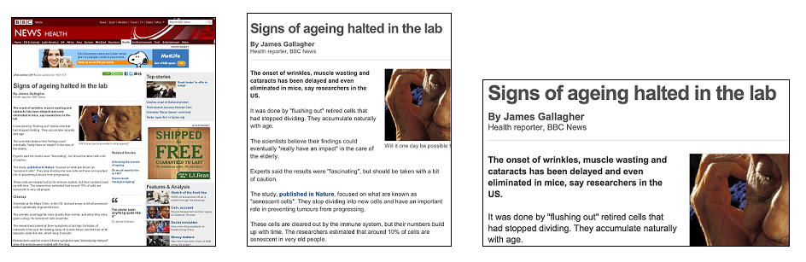
This shows how a typical web page layout displays on a mobile screen

Slide 20
viewport meta tag
The fixed rectangular area within which touch-based smartphone browsers display larger web pages is called the viewport.
Applying a viewport meta tag allows you to control how mobile browsers render content within this rectangle, and whether users can magnify the page.
The following shows a sample screen layout without a viewport. (For the sake of illustration, it displays a flexibly positioned text element that adapts to the full width of the screen, along with a fixed-size background image.) The initially loaded page is zoomed out much too far to be legible, while zooming in makes content extending off the right edge of the screen difficult to access:

Slide 21
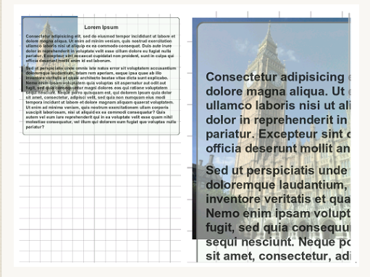
viewport meta tag
This reflects the browser's default assumption that content should extend 980 pixels wide.
Mobile browsers must make that assumption in order to render pages that are not optimized for display on mobile screens.

Slide 22
viewport meta tag
To override the browser's default behaviour, place this line within the HTML's head region:
In the above, we're telling the mobile device to display the page without any zooming.
Setting the viewport width to device-width recalculates flexible CSS measurements (such as the width:100% CSS property) within the width of the handset's screen rather than the default page width, so how much the device is able to fit on the screen is what's shown initially.
So we can now use CSS media queries to cater our webpage to the available real estate on different devices, and not the other way around.

Slide 23
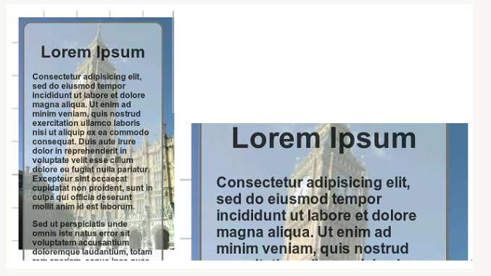
viewport meta tag
Here's how the screen layout looks after you apply the viewport.
So whenever you're optimizing a webpage for mobile devices, the first step is to define the viewport meta tag on your page to alter/ disable the "zoom in" behaviour of mobile browsers.
If your page is optimized for mobile devices (via CSS media queries and changing the layout of webpages accordingly), this "zoom out" behaviour only gets in the way and defeats our efforts.
It means that our CSS media queries will match the dimensions of the "zoomed out" device's, and not its actual (ie: 980px for device-width on the iPhone instead of 320px).

Slide 24
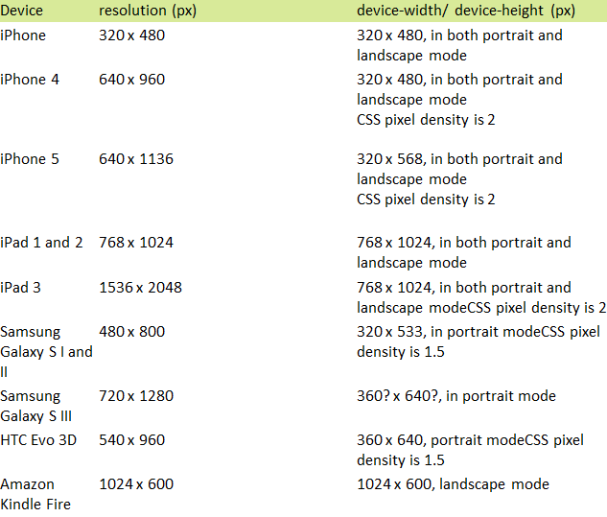
viewport meta tag
Applying a viewport has no effect on desktop browsers. It is interpreted only once when the page loads, and cannot be modified thereafter.
http://docs.webplatform.org/wiki/tutorials/mobile_viewport

Slide 25
Control over zooming Add comment
Once content is well-adapted and properly fit for presentation on mobile browsers, there may no longer be any need to use zoom controls to access different portions of the page.
To disable the browser's default double-tap and pinch-zoom gestures and ensure that content appears at the proper magnification level, apply this viewport:

Slide 26
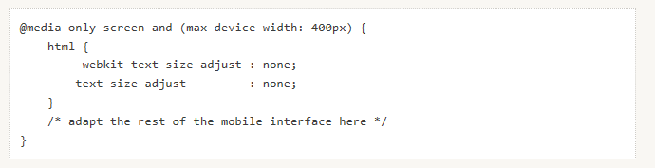
Control over Text-size
To prevent the text size from changing, disable the text-size-adjust CSS property.
Be careful not to apply the CSS above to a desktop-oriented interface. Doing so interferes with the browser's zoom feature, which is not controlled by mobile viewport settings.

